Slide 1
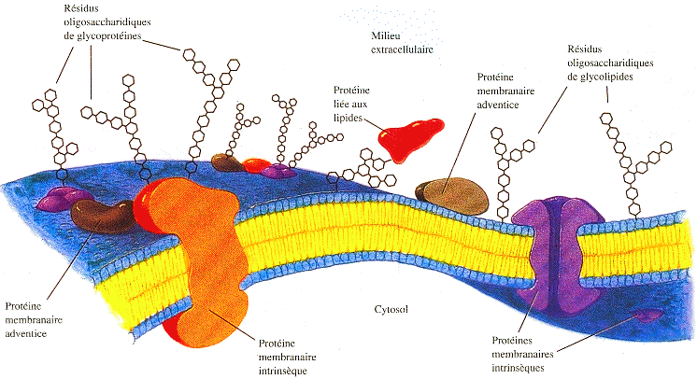
The plasma membrane
Ultra-structural aspect
Dr. AOUATI Amel

Slide 2
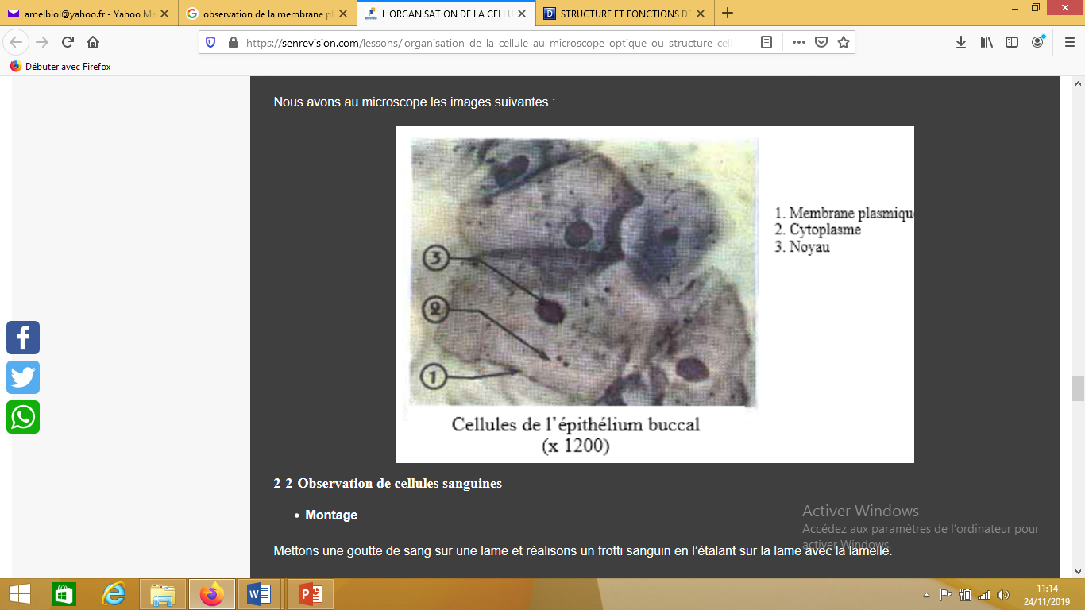
Structure of the plasma membrane
Observation of the plasma membrane under a light microscope reveals a thin border surrounding the cell contents.
Thickness: 7 to 8 nm

Slide 3
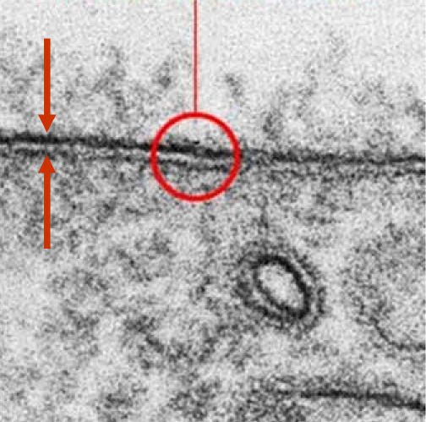
Two techniques are used to study the ultrastructure of the plasma membrane.
The thin section technique, after fixation with osmium tetroxide, reveals a trilamellar structure up to 75 Å thick, composed of three layers: two dark layers separated by a light layer. The outer, dense layer appears coated with a thin glycoprotein film.
The replica technique, after freeze-fracture, shows the plasma membrane fractured into two hemimembranes: an outer exoplasmic hemimembrane and an inner hyaloplasmic hemimembrane.
plasma membrane

Slide 4
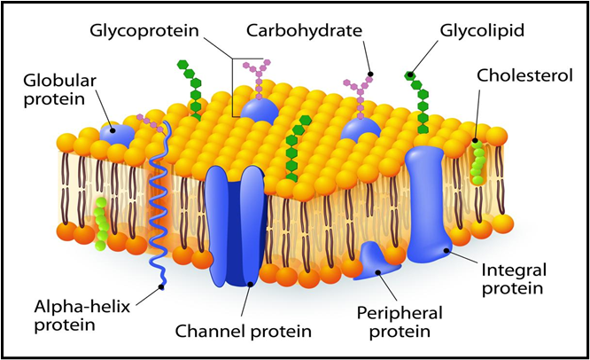
The chemical components of the plasma membrane
Knowledge of the chemical composition of membranes is long-established, while that of their detailed architecture and the function of the various families of molecules that constitute them is relatively recent.
The development of cell fractionation techniques and the power of analytical methods such as electrophoresis have, in recent years, allowed for a very precise understanding of the functional organization of membranes.

Slide 5
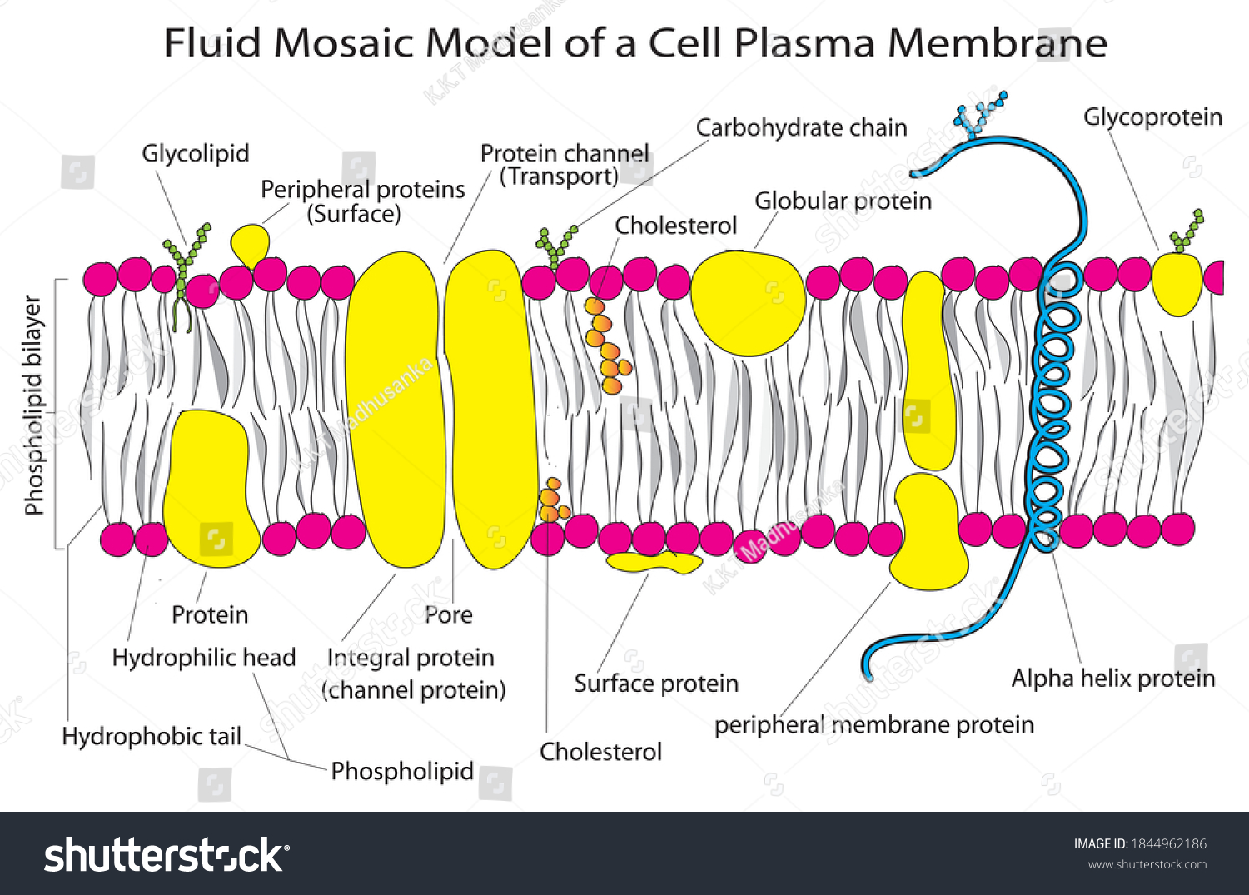
The glycocalyx, or cell coat, is a coating of oligosaccharides carried by glycoproteins and glycolipids, and specific glycoproteins. This molecular coat plays a role in the adhesion and anchoring of the cell to its environment.

Slide 6
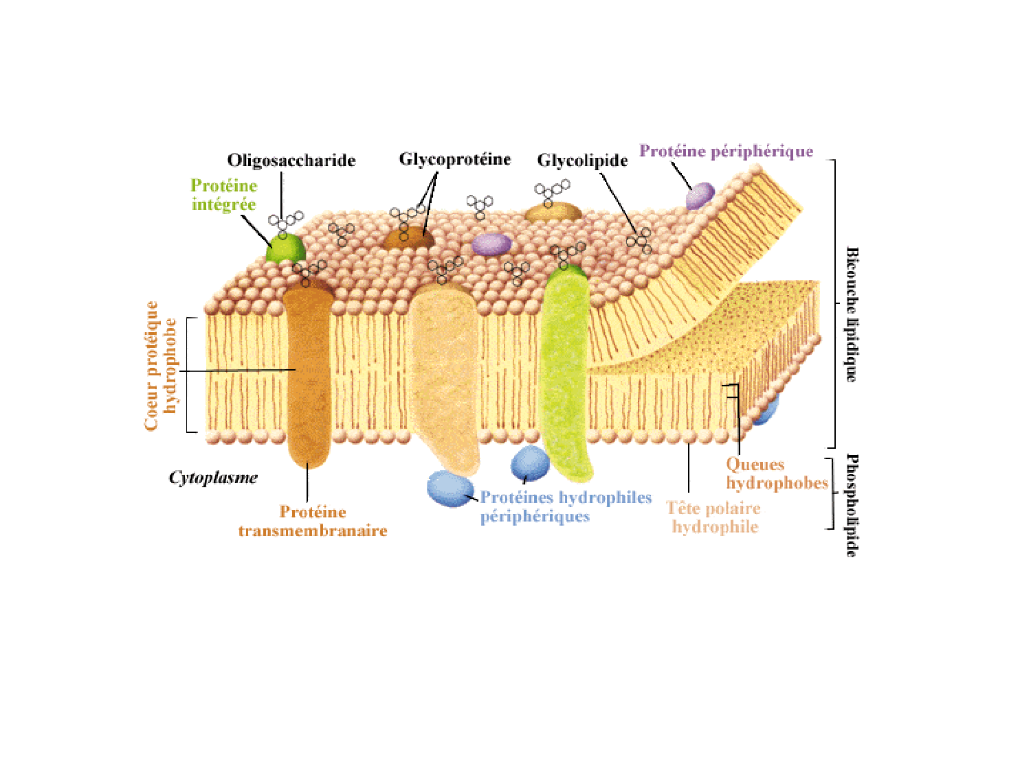
Biological membranes are composed mainly of lipids and proteins
Membrane proteins constitute 20% of the protein mass of cells.
Membrane proteins constitute approximately 40% of the mass of membranes.

Slide 7
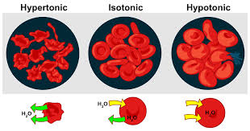

Slide 8
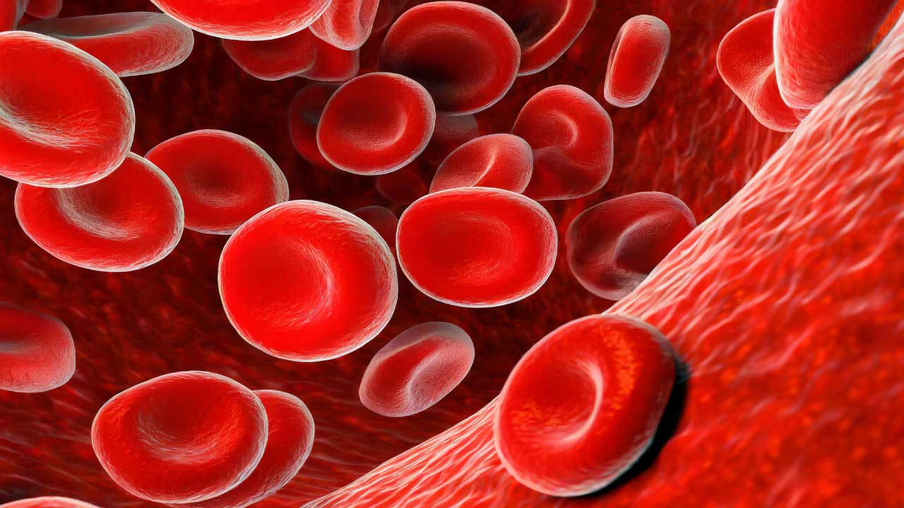
The erythrocyte membrane gives the red blood cell its biconcave shape, plasticity, and deformability. It also carries blood group determinants and represents an ideal model for studying the structure and function of cell membranes.
Carbohydrate, lipid, and protein components are not distributed equally on the outer and inner surfaces of the membrane.
The plasma membrane of red blood cells, for example, is composed of two main constituents distributed in the following proportions: 40% lipids, 52% proteins, and carbohydrates with 8% of the erythrocyte membrane components.

Slide 9
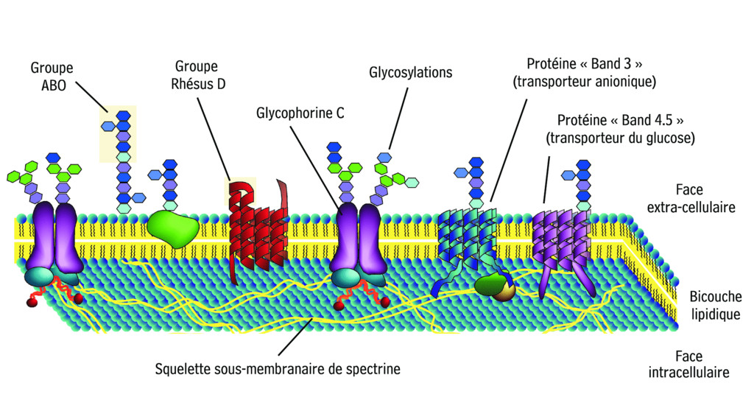
Schematic organization of the red blood cell membrane

Slide 10
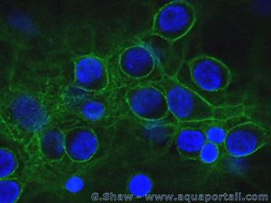
Localization of Spectrin in the erythrocyte membrane
Spectrin is green
Spectrin is a fibrous protein that makes up 30% of the red blood cell membrane proteins. More broadly, spectrins line the intracellular lateral zone of the plasma membrane in eukaryotic cells.
Spectrins are linked to actin filaments and band 4, together forming a protein network with sufficient flexibility to achieve a biconcave shape.
Due to its shape, the erythrocyte is highly elastic and can adapt to pass through blood capillaries, even those with smaller diameters.

Slide 11
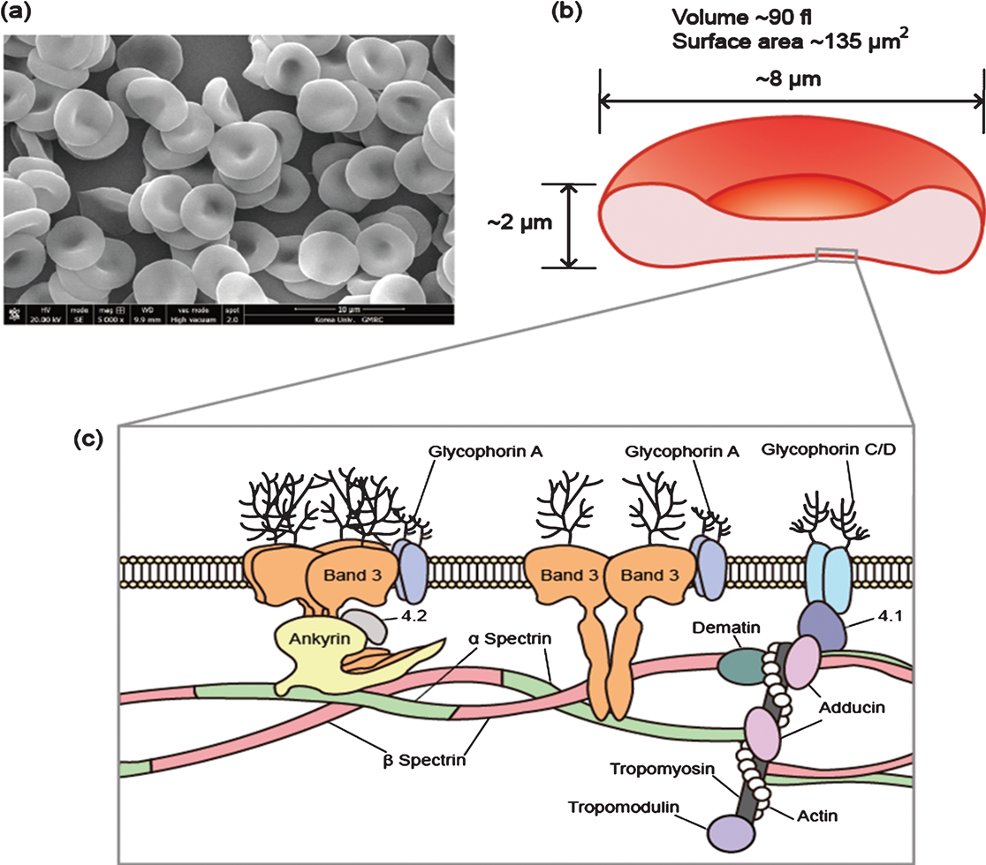
(a) Scanning electron microscopy image of a human red blood cell, (b) The shape of a human red blood cell with average geometric parameters, (c) schematic organization of the red blood cell membrane.

Slide 12
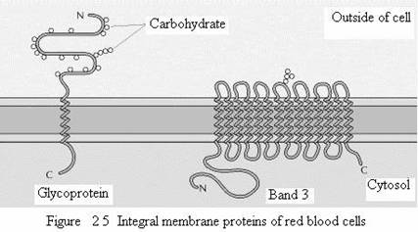
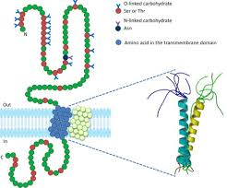
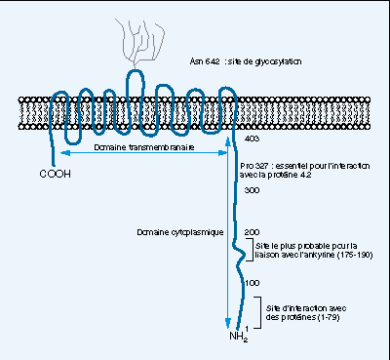
Example of 2 intrinsic proteins of the erythrocyte
Glycophorin A has only one transmembrane α helix
The band 3 protein has 14 transmembrane α-helices

Slide 13
The anion channel in the red blood cell membrane (band 3) is a transmembrane protein that represents approximately 25% of the total protein mass of the red blood cell. This molecule crosses the membrane 14 times. The importance of this protein lies in its biological functions, as it ensures the transport of anions (Cl-, HCO3-) across the membrane. This is a key role in the overall mechanism of CO2 transport from tissues to the lungs because it allows the elimination of intracellular HCO3- (CO2 hydration).
When blood circulates in the tissues, CO2 dissolves in the bloodstream (plasma) and dissociates as follows: H2O + CO2 = HCO3- + H+.
Bicarbonate ions enter the red blood cells in exchange for chloride ions, which leave the cell. In the lungs, where CO2 is released, the reverse reaction occurs, and bicarbonate ions leave the red blood cells in exchange for chloride ions. HCO3- and Cl- ions pass through a channel located in the center of each Band 3 dimer.
Glycophorin A is the protein with the highest saccharide content (80%) and, consequently, the negative electrical charge of the red blood cell. This protein is important for its biological functions, as it plays a role in repelling red blood cells within capillaries and venules.

Slide 14
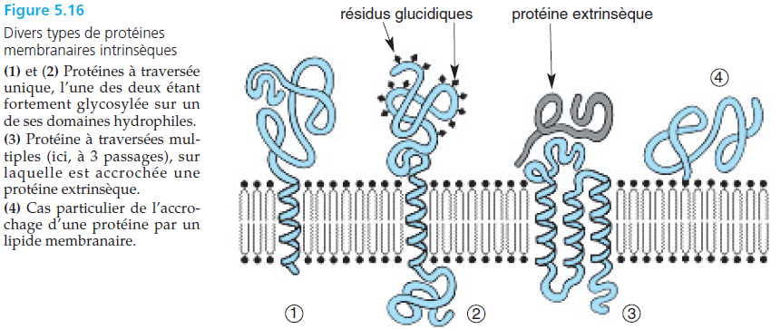
Membrane Proteins:

Slide 15
Transmembrane proteins (intrinsic)
Protéine extrinsèque
Monotopic
A single segment (1 α-helix)
One domain on each side of the membrane
Polytopic
Multiple segments (3 α-helices)
One domain on each side of the membrane

Slide 16
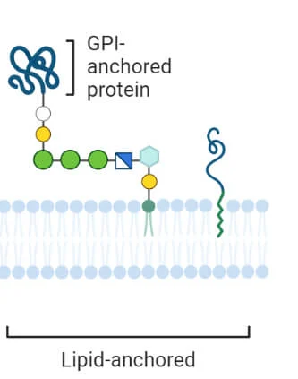
Lipid anchoring
Covalent bond between a protein and a lipid
4 most common modifications:
Isoprenylation: farnesyl or geranylgeranyl, thioester bond, on a cysteine ​​at the C-terminus or near this end.
Myristoylation: myristic acid N-myristoylation: myristic acid on a glycine at the N-terminus.
Palmitoylation: palmitic acid via a thioester bond, on an internal or C-terminal cysteine.
Glypiation: glycosylphosphatidylinositol (GPI) or GPI anchor protein on a C-terminal amino acid

Slide 17
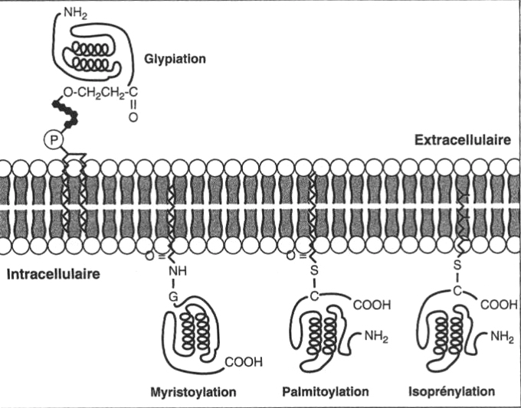

Slide 18
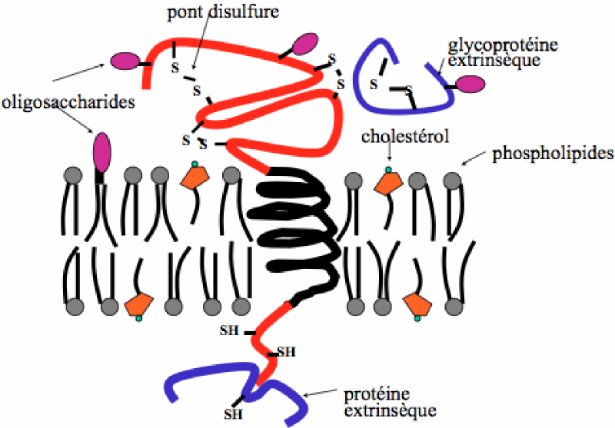
Peripheral Proteins (Extrinsic)
They bind either to the hydrophilic head groups or to the hydrophilic portions of proteins

Slide 19
Membrane Lipids:
From the Greek word “lipos” (fat), are characterized by a physical property: insolubility in aqueous media.
But they are soluble in non polar organic solvents (chloroform, ether, acetone etc.).
They are organic molecules (C,H,O).
They are characterized by the presence of at least one fatty acid in the molecule.
Classification of membrane lipids:
➢ Simple lipids
➢ Complex lipids
➢ Cholesterol

Slide 20
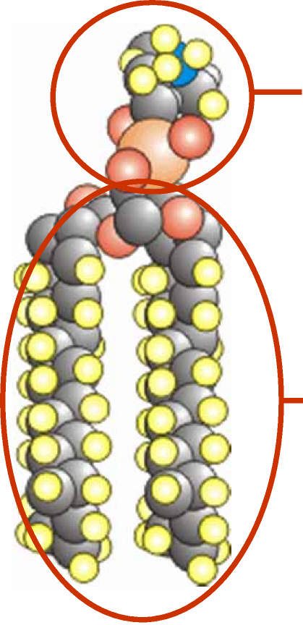
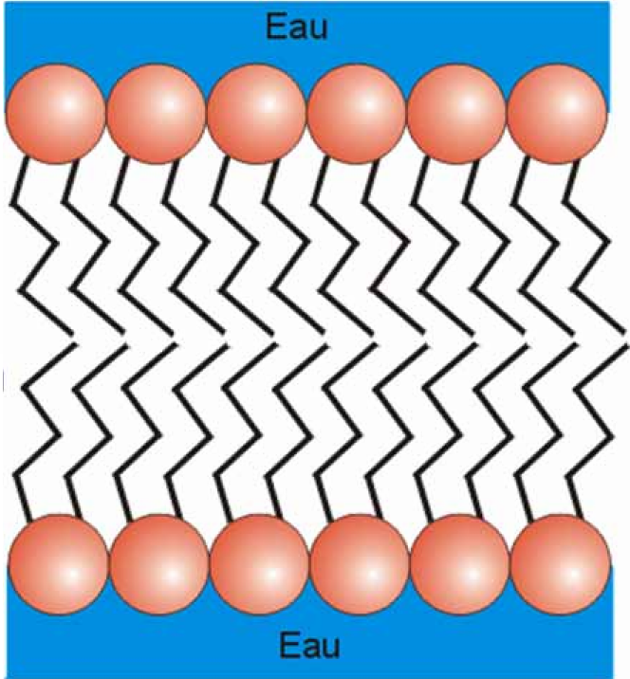
Membrane lipids are amphipathic molecules
Hydrophilic polar group
Hydrophobic nonpolar group

Slide 21
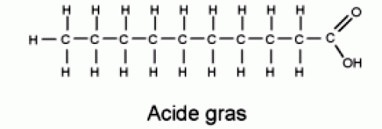
Fatty Acids
These are hydrocarbon chains of varying lengths and degrees of unsaturation, each containing a carboxyl group (-COOH) at one end.
The two ends of a fatty acid molecule have different properties:
The carbohydrate chain is hydrophobic
The carboxyl group is hydrophilic
Hydrophobic group
Hydrophilic group

Slide 22
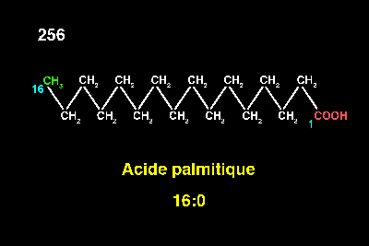
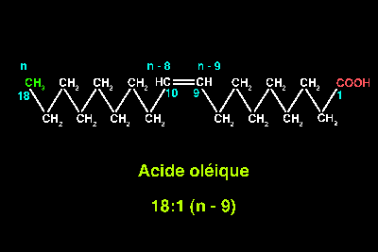
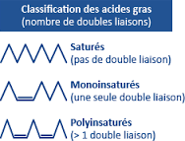
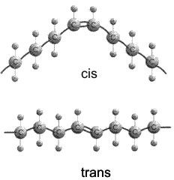
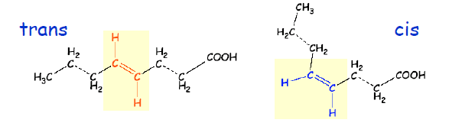

Slide 23
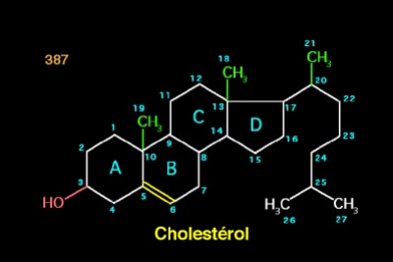
Cholesterol
Cholesterol is composed of a hydrophobic sterol ring, a hydrophobic tail (alkyl radical), and a hydrophilic alcohol group.
In the lipid bilayer of cell membranes, cholesterol molecules are oriented so that the polar head of the OH group, facing the surface, comes into contact with the external or aqueous cytoplasmic environment, while the ring and carbon chain are located deeper within the membrane.
HO

Slide 24
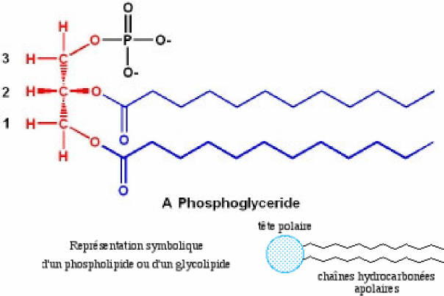
Complex lipids:
If two of the possible bonds on glycerol are occupied by fatty acids and the third by a phosphate group, it is then called a phospholipid or phosphoglyceride. Glycerol and the phosphate group are hydrophilic and form a polar head that is attracted to water, while the fatty acid chains are hydrophobic and form a nonpolar tail that repels water. Hence the symbolic representation of a phospholipid shown opposite.

Slide 25
Phospholipids
Example of phosphoglycerides
GLYCEROL
ACIDE GRAS
ACIDE GRAS
ALCOOL
PHOSPHATE

Slide 26
… are made up of glycerol,
H₂C
OH
HC
OH
HO
CH₂
glycerol

Slide 27
… of two fatty acids,
O
palmitate
H₂C
O
C
(CH₂)₁₄
CH₃
HC
O
C
(CH₂)₇
CH
CH
(CH₂)₇
CH₃
O
HO
CH₂
oleate
glycerol
Fatty acids

Slide 28
… of one phosphate
O
palmitate
H₂C
O
C
(CH₂)₁₄
CH₃
HC
O
C
(CH₂)₇
CH
CH
(CH₂)₇
CH₃
O
O
HO
P
O
CH₂
oleate
O⁻
phosphate
glycérol
Fatty acids

Slide 29
…and an alcohol
O
palmitate
H₂C
O
C
(CH₂)₁₄
CH₃
HC
O
C
(CH₂)₇
CH
CH
(CH₂)₇
CH₃
H₃C
O
O
H₃C
N⁺
CH₂
CH₂
O
P
O
CH₂
oleate
H₃C
O⁻
alcool
phosphate
glycerol
Fatty acids
phosphatidylcholine

Slide 30
The diversity of phospholipids results from the association of different polar heads...
H₃N⁺
CH₂
CH₂
OH
NH₃⁺
⁻OOC
CH
CH₂
OH
Ethanolamine
OH
OH
serine
H
OH
H₃C
H
H
OH
H
H₃C
N⁺
CH₂
CH₂
OH
HO
H
H₃C
choline
H
OH
inositol
proportion en %
Cell
Membrane
Mitochondria
Endoplasmic
Reticulum
Phosphatidylethanolamine
Phosphatidylserine
Phosphatidylcholine
Phosphatidylinositol
Sphingomyelin
Glycolipides
Cholesterol
7
4
24
< 1
19
7
17
35
2
39
0
0
0
3
17
5
40
0
5
0
6

Slide 31
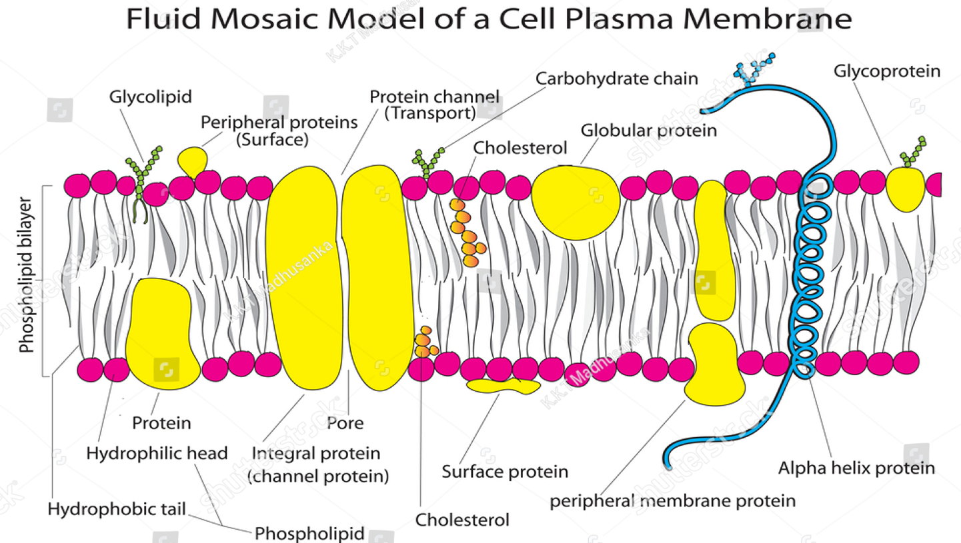
Movement of membrane lipids and proteins
A phospholipid can move laterally within the same leaflet with great ease. It has been estimated that a phospholipid can diffuse from one end of a bacterium to the other in one or two seconds.
Of all the possible movements of a phospholipid, flipping to the other side of the membrane is the most limited, because for this transverse movement, the hydrophilic group of the lipid would have to cross the inner hydrophobic layer of the membrane. Indeed, cells possess enzymes, called flippases, which actively move certain phospholipids from one leaflet to the other. These enzymes can play a role in establishing lipid asymmetry.

Slide 32
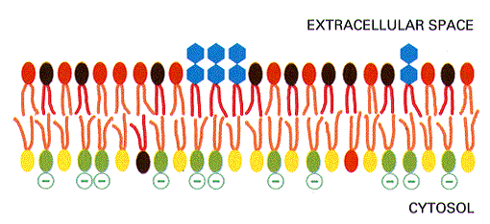
The distribution of lipids is asymmetrical
Example of the cell membrane
Exterior interior
Phosphatidylserine
Phosphatidylethanolamine
Phosphatidylcholine
Glycolipids
10
10
90
100
90
90
10
0
Flippases primarily transport phosphatidylserine and phosphatidylethanolamine from the extracellular leaflet to the cytosolic leaflet of the plasma membrane.
Floppases also transport cholesterol and phosphatidylcholine from the cytosolic leaflet to the extracellular leaflet.

Slide 33
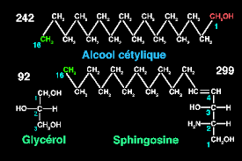
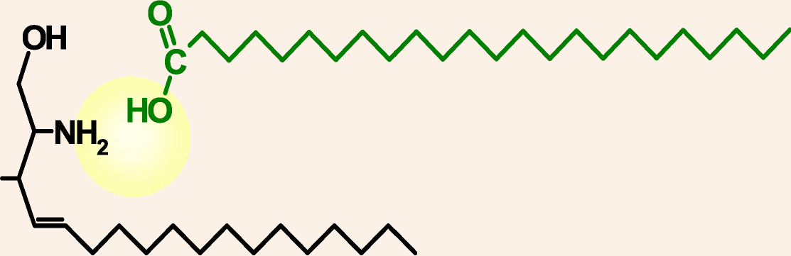
Sphingolipids:
These are amides of sphingosine that are formed by the linkage of the carboxyl group of the fatty acid to the -NH2 group of sphingosine.
HO

Slide 34
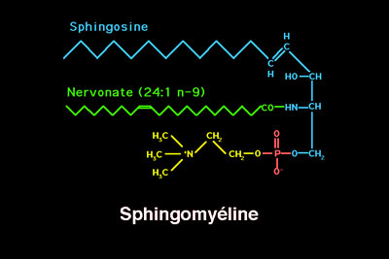
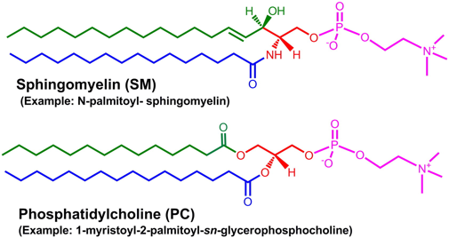
Sphingomyelins are membrane phospholipids, present in all membranes but especially in the nervous system (myelin sheaths).
They are composed of sphingosine, a fatty acid that amidizes the amine function, and a phosphate that esterifies the primary alcohol function and is itself esterified by an amino alcohol (choline).

Slide 35
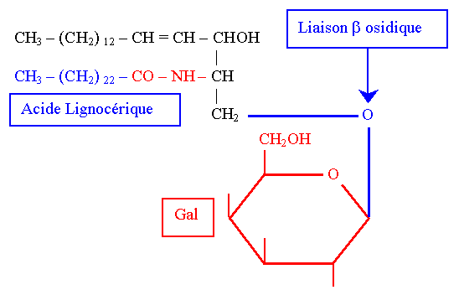
Glycolipids
Cérébrogalactosides Ils sont constitués de :
 | Sphingosine + AG + βD Galactose
Le galactose est uni à l’alcool primaire de la sphingosine par une liaison β osidique
B. Les Cérébroglucides Ils sont constitués de :
Sphingosine + AG + βD Glucose
La liaison est β osidique.
C. Les Gangliosides Ils sont constitués de :
Sphingosine + AG + chaîne de plusieurs oses et dérivés d’oses
Ils sont abondants dans les ganglions d’où leur nom.
These oligosides are present on the outer surface of the plasma membrane. They are specific, therefore recognized by proteins (bacterial toxins, lectins).
Example: blood group antigens
Antigens A and B are oligosaccharides carried by the membrane glycolipids and glycoproteins of red blood cells, epithelial cells, and endothelial cells. We also note their presence in plasma, saliva, or milk.

Slide 36
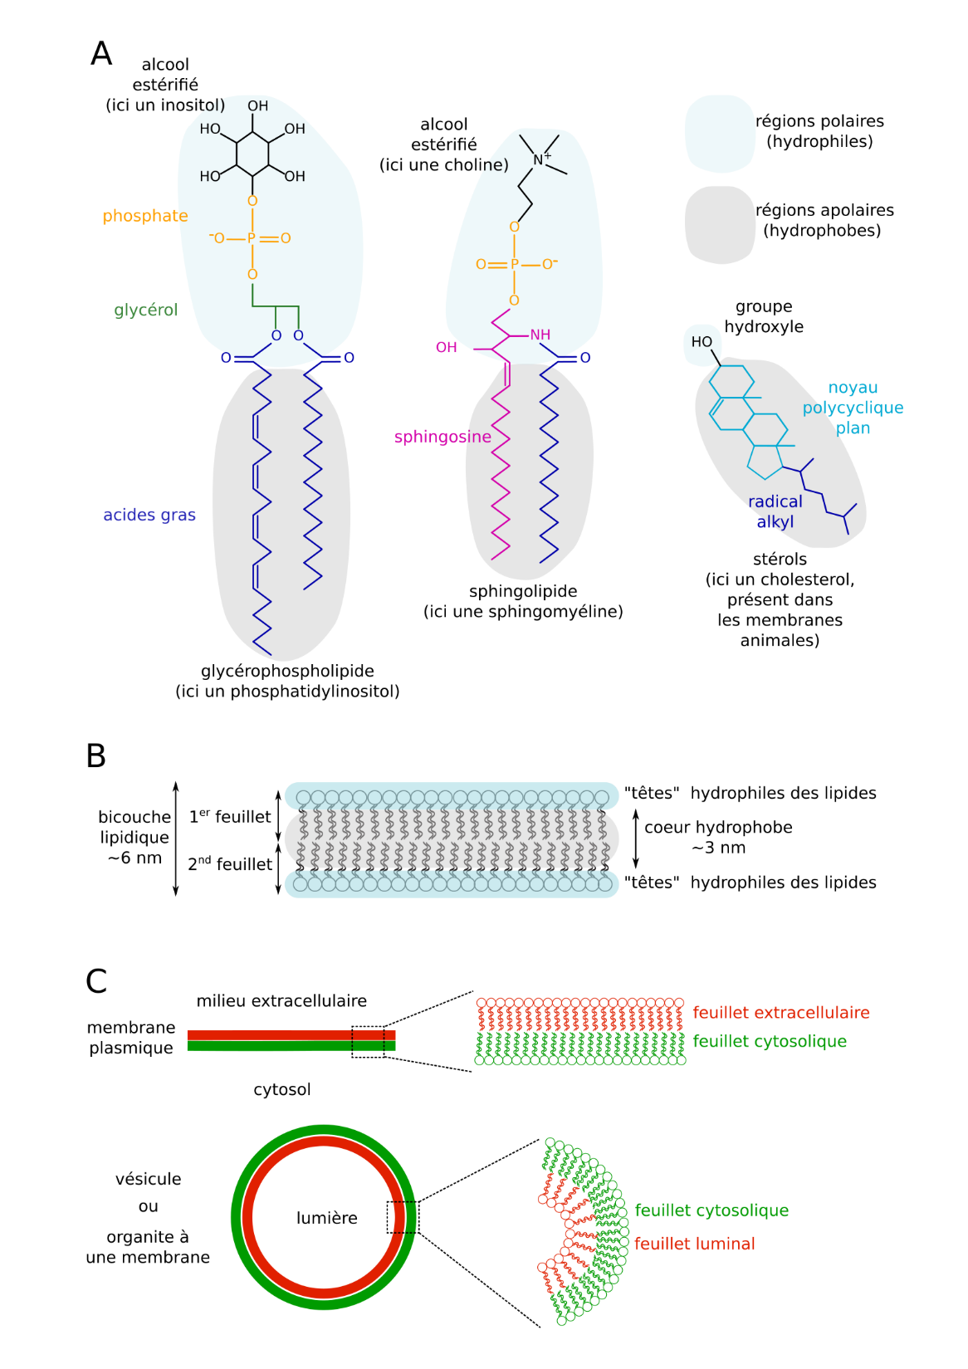
Membrane lipids form lipid bilayers
Three examples of membrane lipids.
Self-organization of membrane lipids into a bilayer.

Slide 37
Properties of the chemical components of the plasma membrane
The chemical constituents of the plasma membrane have different properties, playing distinct roles within the bilayer.
Membrane lipids influence the fluidity of the membrane, which depends on the unsaturation of the phospholipids that make it up. Thus, the unsaturation of the hydrocarbon chains increases membrane fluidity, and a drop in temperature also triggers the synthesis of unsaturated membrane lipids, leading to an increase in membrane fluidity. Cholesterol strengthens the membrane's solidity because by positioning itself between phospholipid molecules, it immobilizes neighboring hydrocarbon chains, making the membrane more rigid.
Membrane proteins have very specific roles within the phospholipid bilayer; they can act as receptors, transporters, enzymatic catalysts, intracellular messengers or adhesion molecules.
Carbohydrates are involved in signaling and in the negative charge of the membrane due to the presence of sialic acid.

Slide 38
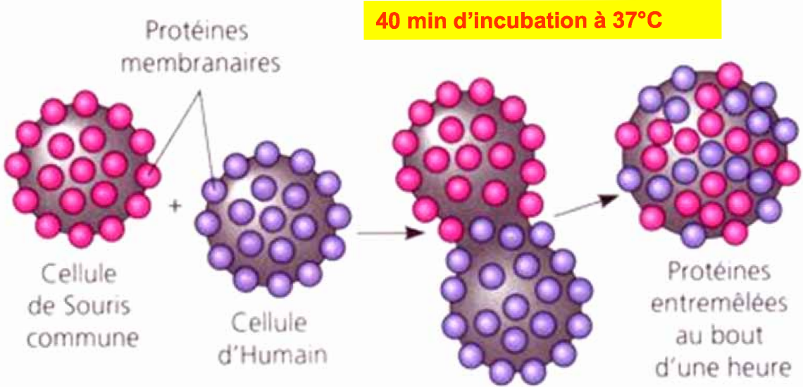
Mobility of membrane proteins
In 1970, Frye and Edidin were able to create cell hybrids or heterokaryons by fusing a human cell with a mouse cell to study protein mobility.

Slide 39
Carbohydrates or Saccharides
Basic unit: monosaccharides
Metabolic breakdown: source of energy (glycolysis)
Monosaccharides such as glucose, fructose…they are components of nucleic acids and some complex lipids
Oligosaccharides a few monosaccharides covalently linked; often associated with proteins (glycoproteins) or lipids (glycolipids)
Polysaccharides many monosaccharides covalently linked, structural roles (cellulose) or storage roles (starch, glycogen)

